Slide 1

Section 5
Energy
Emma

Slide 2
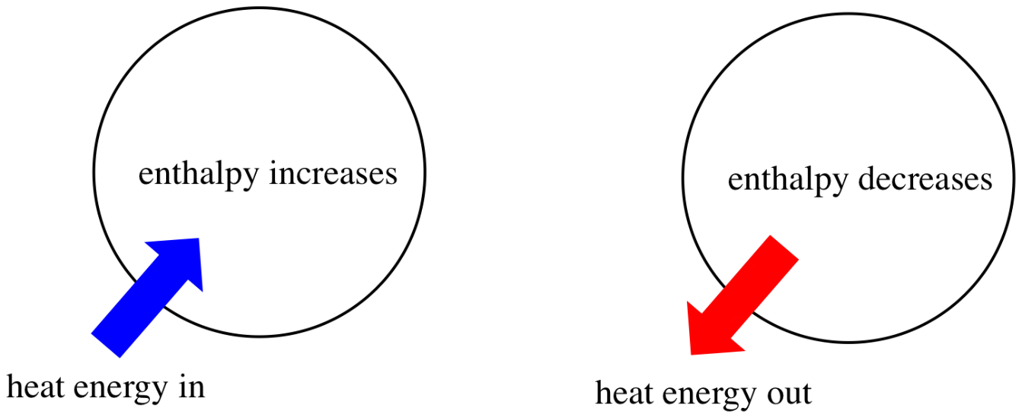
Part 1 1
Thermodynamics
Enthalpy (焓)

Slide 3
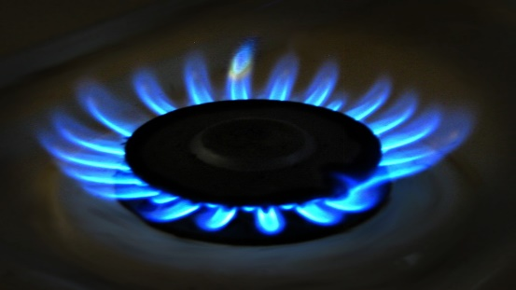


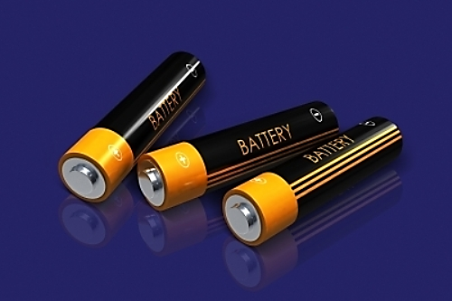
Enthalpy

Slide 4

Enthalpy（焓）
The energy exchange between a chemical reaction and its surroundings at constant pressure is the enthalpy change (ΔH) (焓变)
Enthalpy (焓)(H) can be considered as the heat at constant pressure
Breaking bonds absorb energy 断键吸热 Making bonds release energy 成键放热

Slide 5
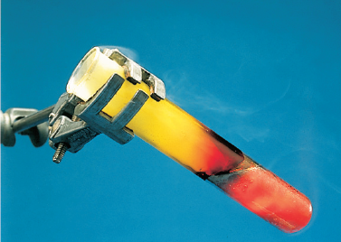
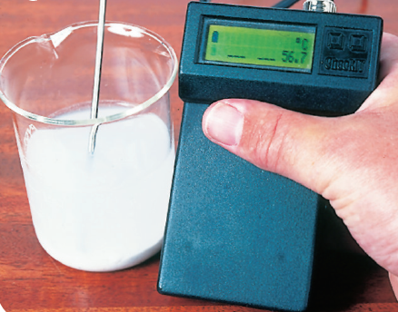
Exothermic reaction
To start off the reaction between iron and sulfur, you must heat the mixture. But soon it glows red hot - without the Bunsen burner!
When you add water to lime (calcium oxide) heat is given out, so the temperature rises. Here the rise is being measured.

Slide 6
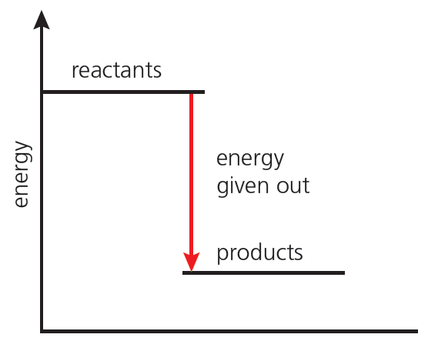
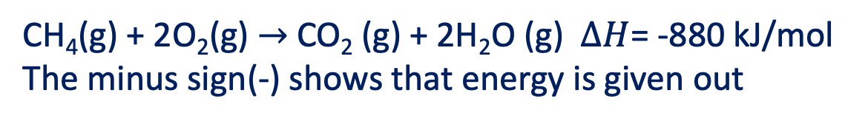
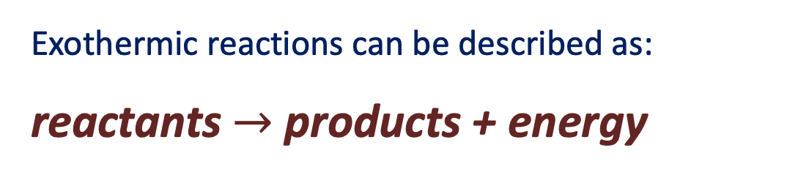
Exothermic reaction
Exothermic reactions can be described as:
reactants $→$ products + energy
CH₄(g) + 2O₂(g) $→$CO₂ (g) + 2H₂O (g) $∆H$= -880 kJ/mol The minus sign(-) shows that energy is given out
reaction progress
An energy level diagram for an exothermic reaction. The products have lower energy than the reactants

Slide 7
Exothermic reaction
Common Exothermic reaction
燃烧反应 combustion
置换反应 single displacement（活泼金属与水或酸的反应）
中和反应 neutralization
大多数化合反应 synthesis

Slide 8
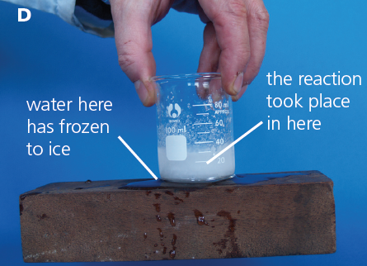
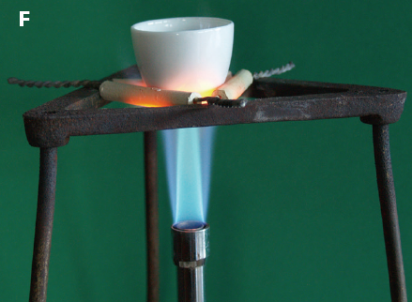
Endothermic reaction
When barium hydroxide(Ba(OH)₂) reacts with ammonium chloride(NH₄Cl), the temperature falls so sharply that water under the beaker will freeze
The crucible(坩埚) contains calcium carbonate(CaCO₃). If you keep on heating,
it will all decompose to calcium oxide(CaO) and carbon dioxide.

Slide 9
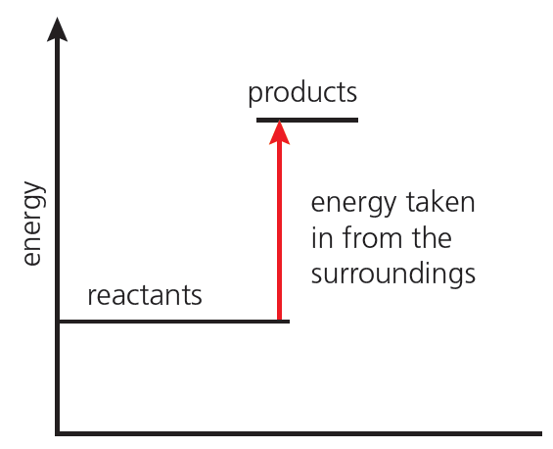
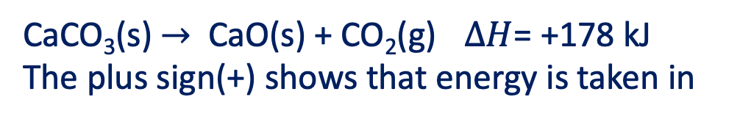
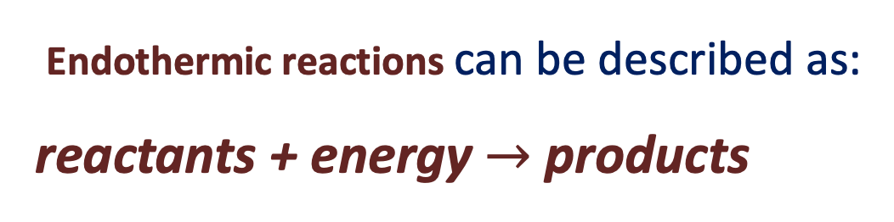

Endothermic reaction
Endothermic reactions can be described as:
reactants + energy$→$ products
CaCO₃(s) $→$ CaO(s) + CO₂(g) $∆H$= +178 kJ The plus sign(+) shows that energy is taken in
reaction progress
energy level diagram for an endothermic reaction. The products have higher energy than the reactants.

Slide 10
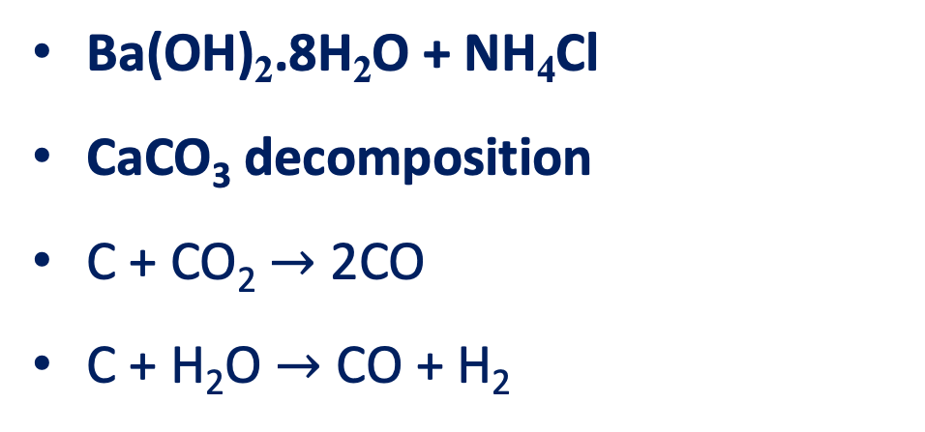
Endothermic reaction
Common Endothermic Reaction
Ba(OH)₂.8H₂O + NH₄Cl
CaCO₃ decomposition
C + CO₂ $→$ 2CO
C + H₂O $→$ CO + H₂

Slide 11
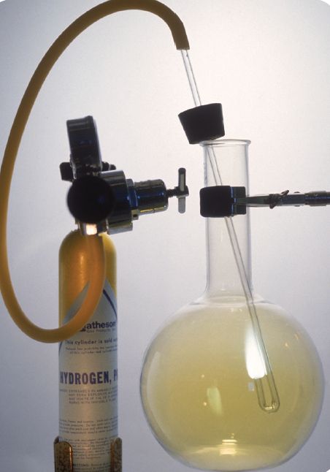
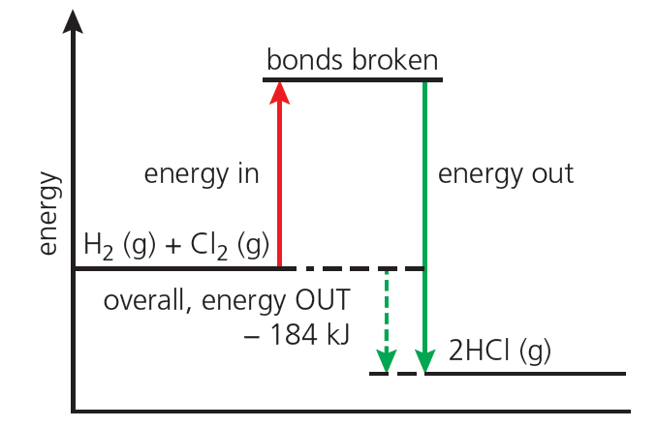
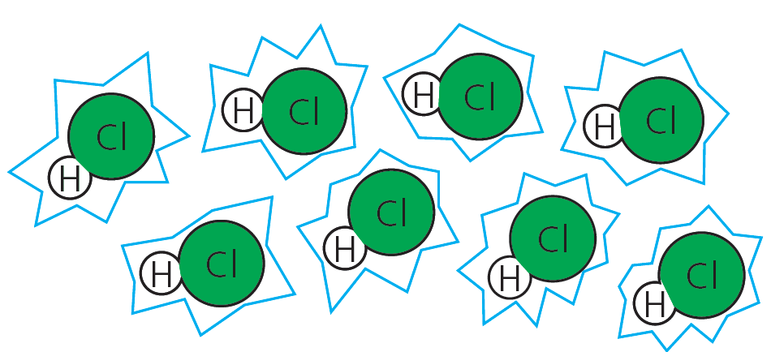
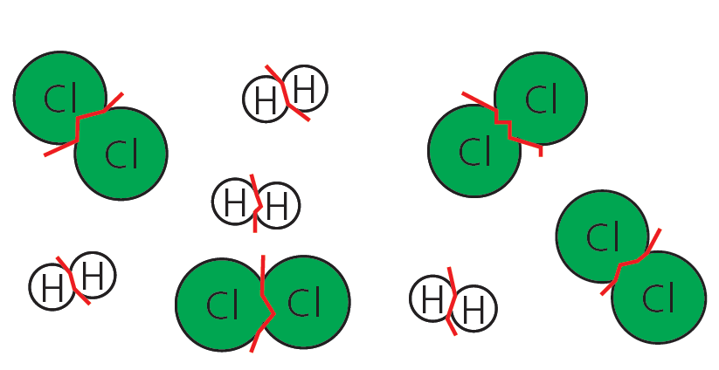

Explaining energy changes
Bond Enthalpy 键焓 amount of energy needed to break one mole covalent bond
Breaking bonds absorb energy 断键吸热 Making bonds releases energy 成键放热
bonds in the H₂ and Cl₂ molecules must be Broken. which absorbs energy
new bonds form between H and Cl atoms, forming HCl.
Which releases energy
Hydrogen burning in chlorine in the lab.

Slide 12
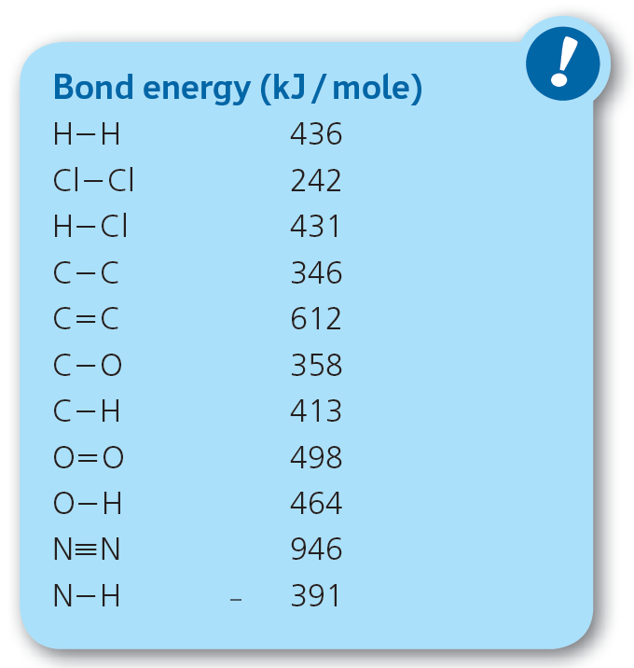
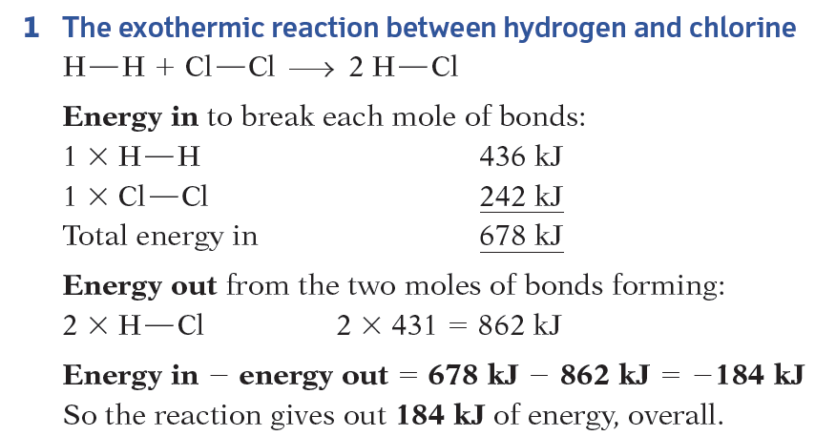

Bond energies(键能)
Bond Enthalpy 键焓 amount of energy needed to break one mole covalent bond

Slide 13
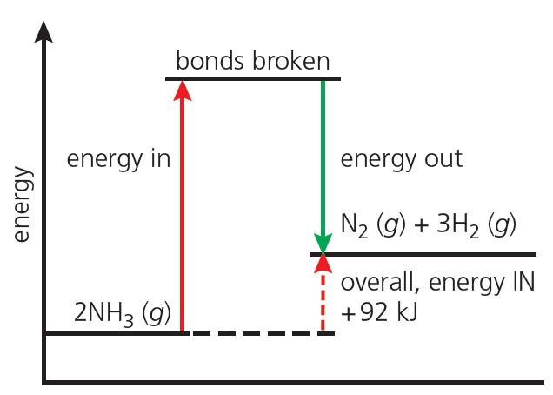
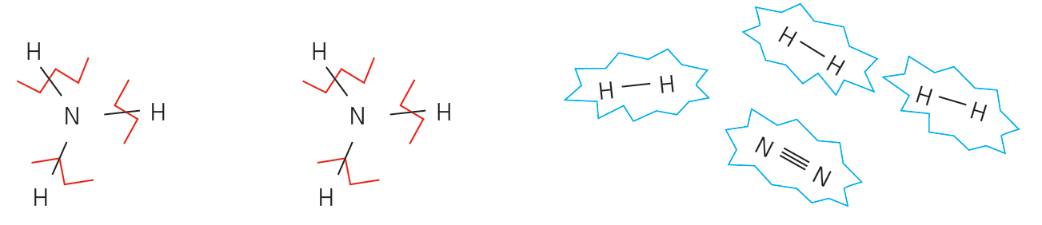
Explaining energy changes
Bond Enthalpy 键焓 amount of energy needed to break one mole covalent bond
bonds in NH₃ must be broken which absorbs energy
Then the hydrogen atoms bond together. So do the nitrogen atoms.
Which releases energy

Slide 14
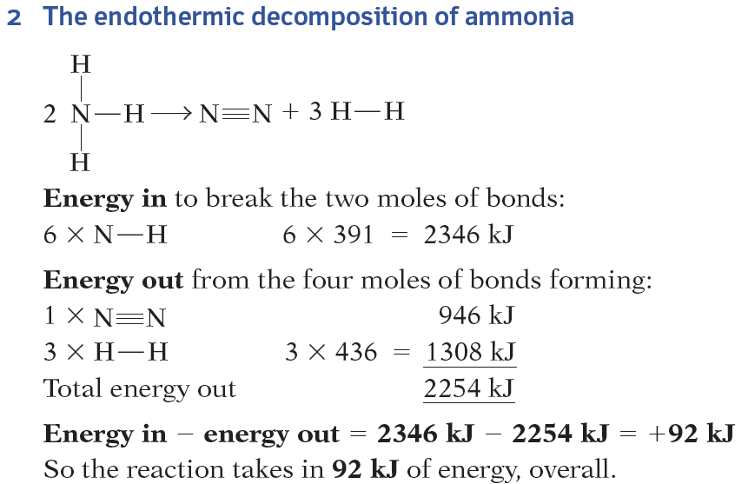

Bond energies(键能)
Bond Enthalpy 键焓 amount of energy needed to break one mole covalent bond

