Slide 1
Section 5
Energy
Emma

Slide 2
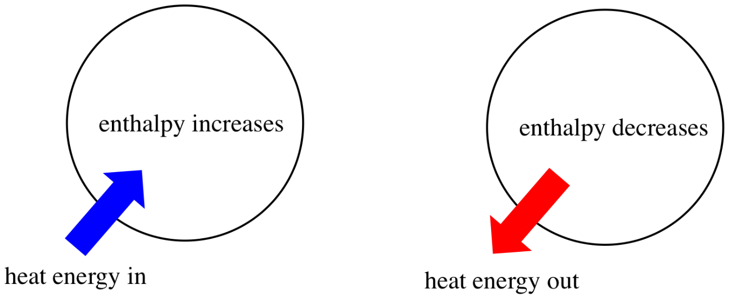
Part 1 1
Thermodynamics
Enthalpy (焓)

Slide 3
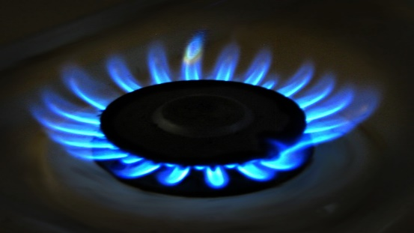
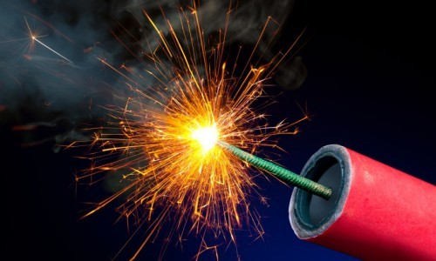
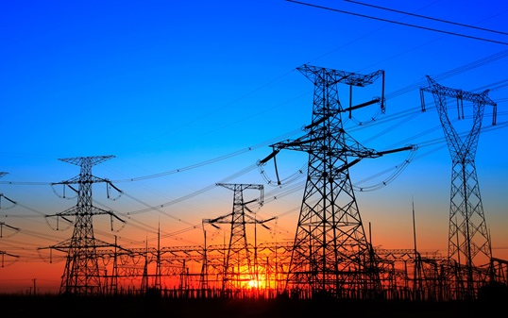
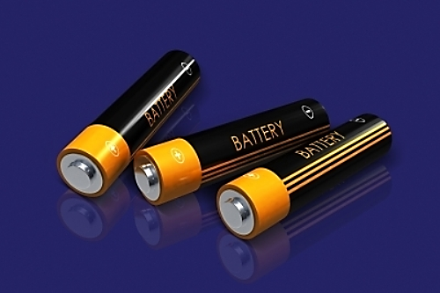
Enthalpy

Slide 4

Enthalpy（焓）
The energy exchange between a chemical reaction and its surroundings at constant pressure is the enthalpy change (ΔH) (焓变)
Enthalpy (焓)(H) can be considered as the heat at constant pressure
Breaking bonds absorb energy 断键吸热 Making bonds release energy 成键放热

Slide 5
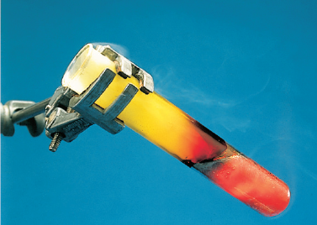
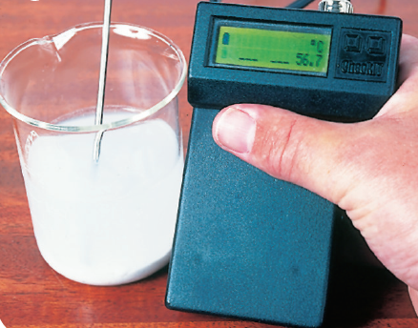
Exothermic reaction
To start off the reaction between iron and sulfur, you must heat the mixture. But soon it glows red hot - without the Bunsen burner!
When you add water to lime (calcium oxide) heat is given out, so the temperature rises. Here the rise is being measured.

Slide 6
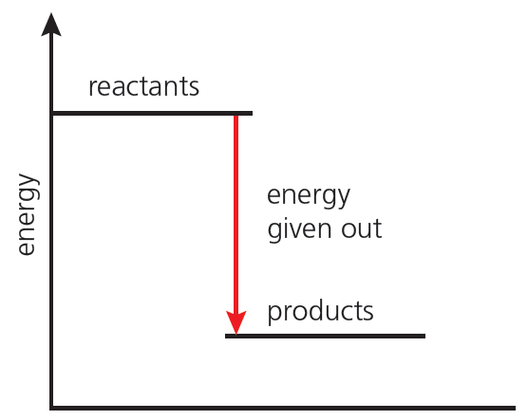
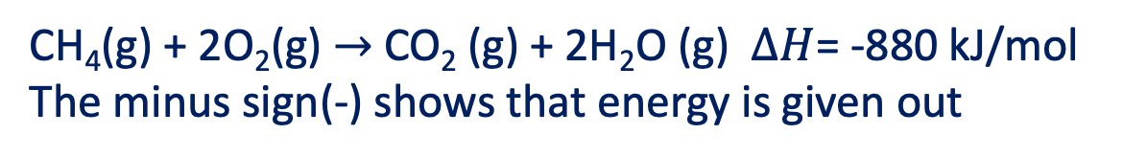
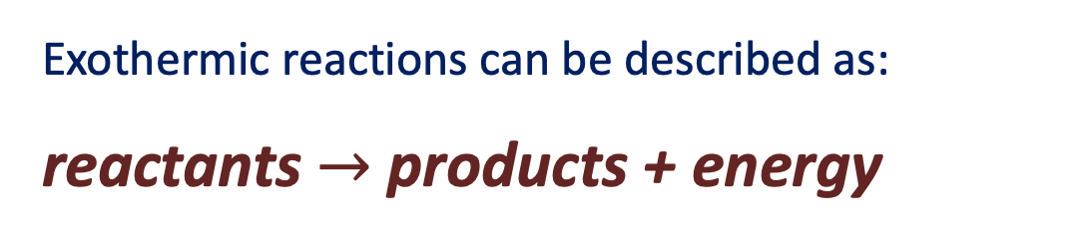
Exothermic reaction
Exothermic reactions can be described as:
reactants $→$ products + energy
CH₄(g) + 2O₂(g) $→$CO₂ (g) + 2H₂O (g) $∆H$= -880 kJ/mol The minus sign(-) shows that energy is given out
reaction progress
An energy level diagram for an exothermic reaction. The products have lower energy than the reactants

Slide 7
Exothermic reaction
Common Exothermic reaction
燃烧反应 combustion
置换反应 single displacement（活泼金属与水或酸的反应）
中和反应 neutralization
大多数化合反应 synthesis

Slide 8
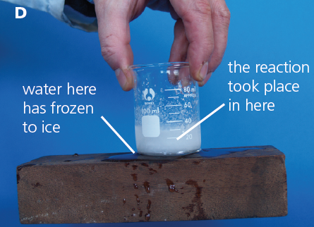
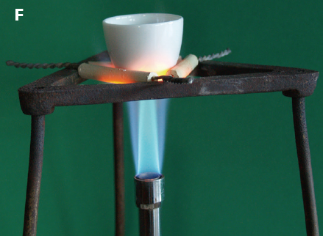
Endothermic reaction
When barium hydroxide(Ba(OH)₂) reacts with ammonium chloride(NH₄Cl), the temperature falls so sharply that water under the beaker will freeze
The crucible(坩埚) contains calcium carbonate(CaCO₃). If you keep on heating,
it will all decompose to calcium oxide(CaO) and carbon dioxide.

Slide 9
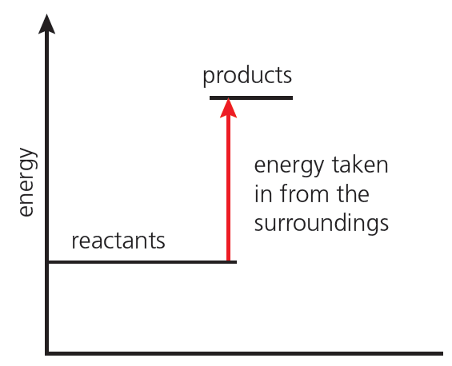
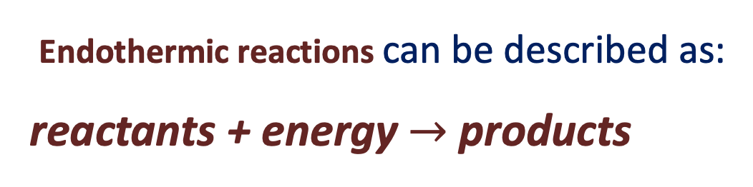
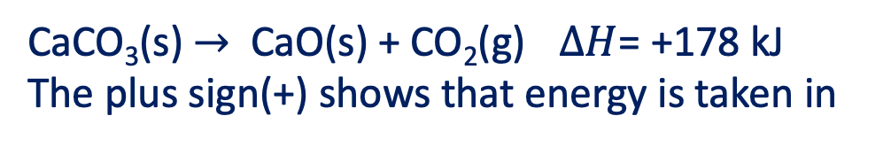
Endothermic reaction
Endothermic reactions can be described as:
reactants + energy$→$ products
CaCO₃(s) $→$ CaO(s) + CO₂(g) $∆H$= +178 kJ The plus sign(+) shows that energy is taken in
reaction progress
energy level diagram for an endothermic reaction. The products have higher energy than the reactants.

Slide 10
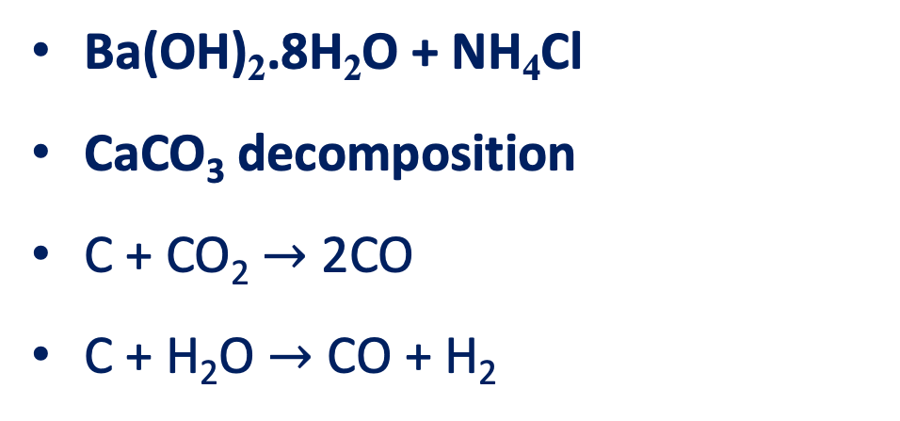
Endothermic reaction
Common Endothermic Reaction
Ba(OH)₂.8H₂O + NH₄Cl
CaCO₃ decomposition
C + CO₂ $→$ 2CO
C + H₂O $→$ CO + H₂

Slide 11
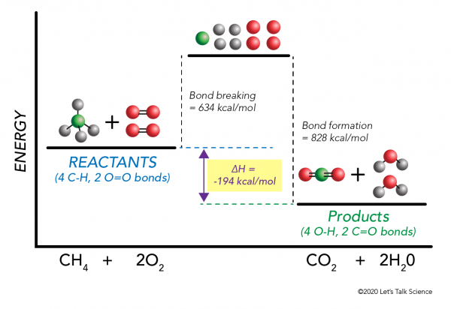
Bond energies(键能)

Slide 12
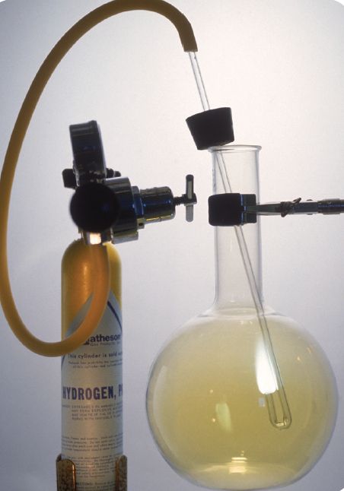
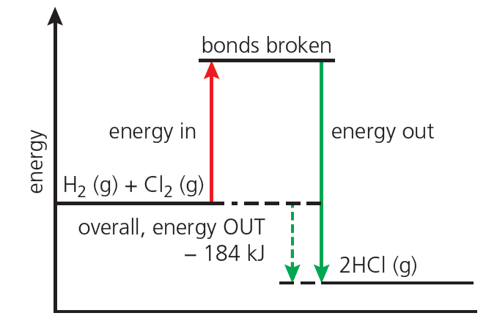
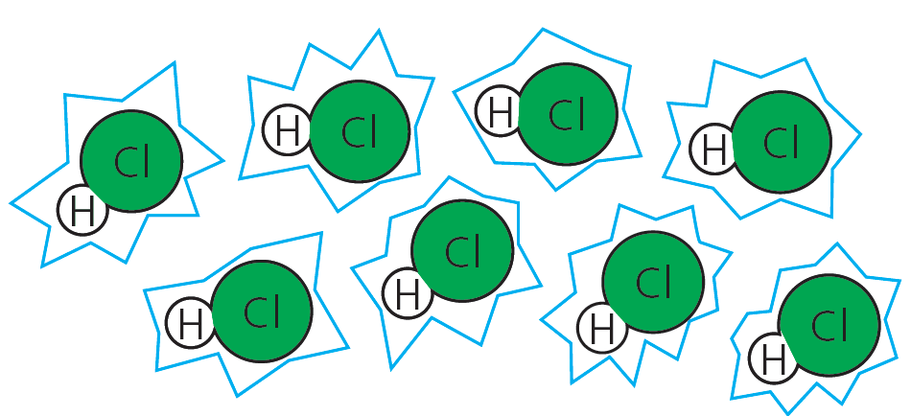
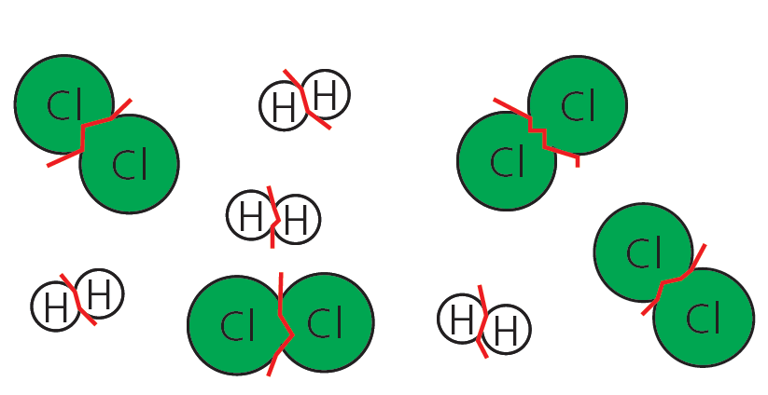
Explaining energy changes
Bond Enthalpy 键焓 amount of energy needed to break one mole covalent bond
Breaking bonds absorb energy 断键吸热 Making bonds releases energy 成键放热
bonds in the H₂ and Cl₂ molecules must be Broken. which absorbs energy
new bonds form between H and Cl atoms, forming HCl.
Which releases energy
Hydrogen burning in chlorine in the lab.

Slide 13
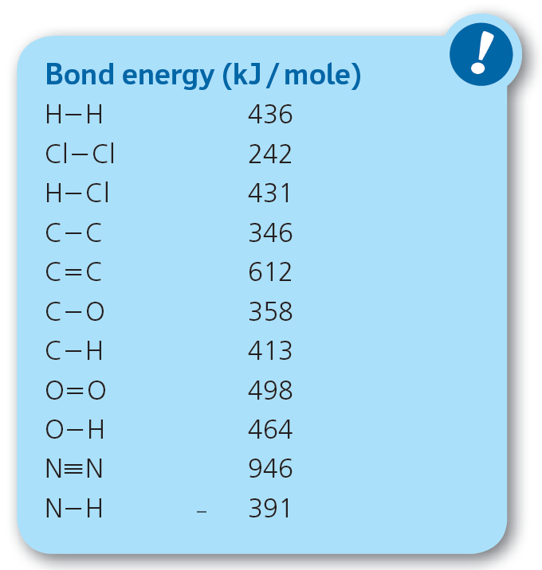
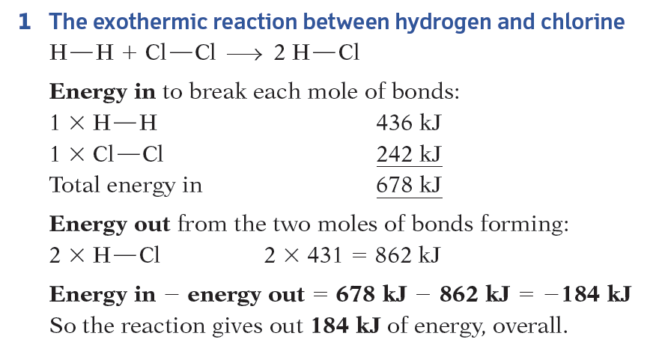
Bond energies(键能)
Bond Enthalpy 键焓 amount of energy needed to break one mole covalent bond

Slide 14
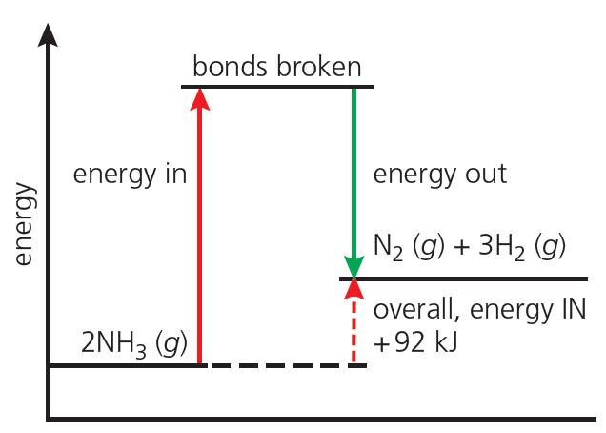
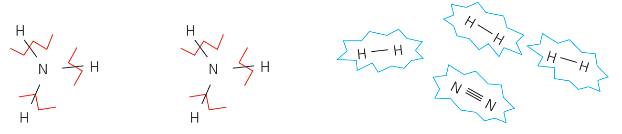
Explaining energy changes
Bond Enthalpy 键焓 amount of energy needed to break one mole covalent bond
bonds in NH₃ must be broken which absorbs energy
Then the hydrogen atoms bond together. So do the nitrogen atoms.
Which releases energy

Slide 15
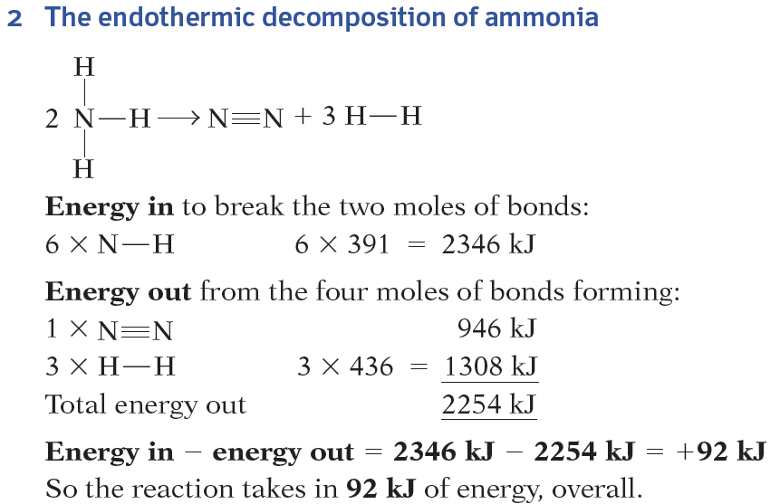
Bond energies(键能)
Bond Enthalpy 键焓 amount of energy needed to break one mole covalent bond

Slide 16
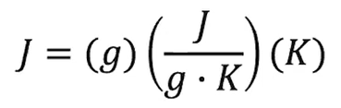

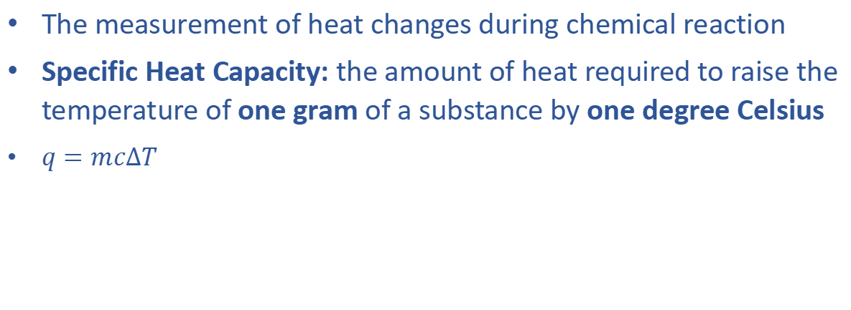
Calorimetry(量热学)
The measurement of heat changes during chemical reaction
Specific Heat Capacity: the amount of heat required to raise the temperature of one gram of a substance by one degree Celsius
$q=mc∆T$
Notes:
molar Heat Capacity: the amount of heat required to raise the temperature of one mol of a substance by one degree Celsius

Slide 17
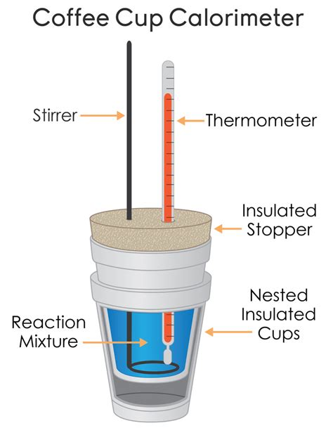
Calorimetry(量热学)
Experimental Determination of Enthalpy Changes by Calorimetry
Calorimeter(热量计) = a container used for measuring the temperature change of solution
When a reaction occurs in a calorimeter
The heat lost/gained by the reacting system
the heat gained/lost by the calorimeter and its contents
=
Determination of Enthalpy Change ($∆H$)of Neutralization
Notes:
experimental 美 [ɛk'spɛrɪ'mɛntəl]
constant-pressure calorimetry
A coffee-cup calorimeter made of two Styrofoam cups.

Slide 18
操作步骤：
塑料杯，一次性纸杯，棉花，温度计 稀盐酸，氢氧化钠溶液
Add 20mL 1mol/L hydrochloric acid solution to paper cup
Measure initial temperature T1
Add 20mL 1mol/L sodium hydroxide solution to the same paper cup
Take the temperature of the mixture every 30 seconds and record the highest temperature
Calculate heat change Q

Slide 19
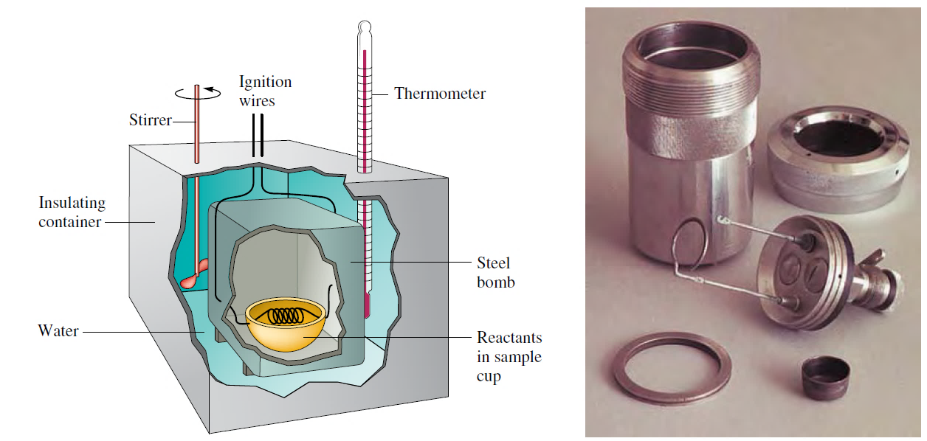
Calorimetry(量热学)
bomb calorimeter 弹式量热计
The reaction is carried out inside a rigid steel “bomb” (photo of actual disassembled “bomb’’ shown on right)
the heat evolved is absorbed by the surrounding water and other calorimeter parts.
The quantity of energy produced by the reaction can be calculated from the temperature increase.

Slide 20
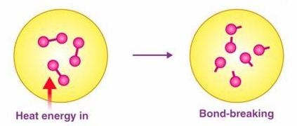
Part 2 1
Thermodynamics
BOND ENERGY(键能)

Slide 21
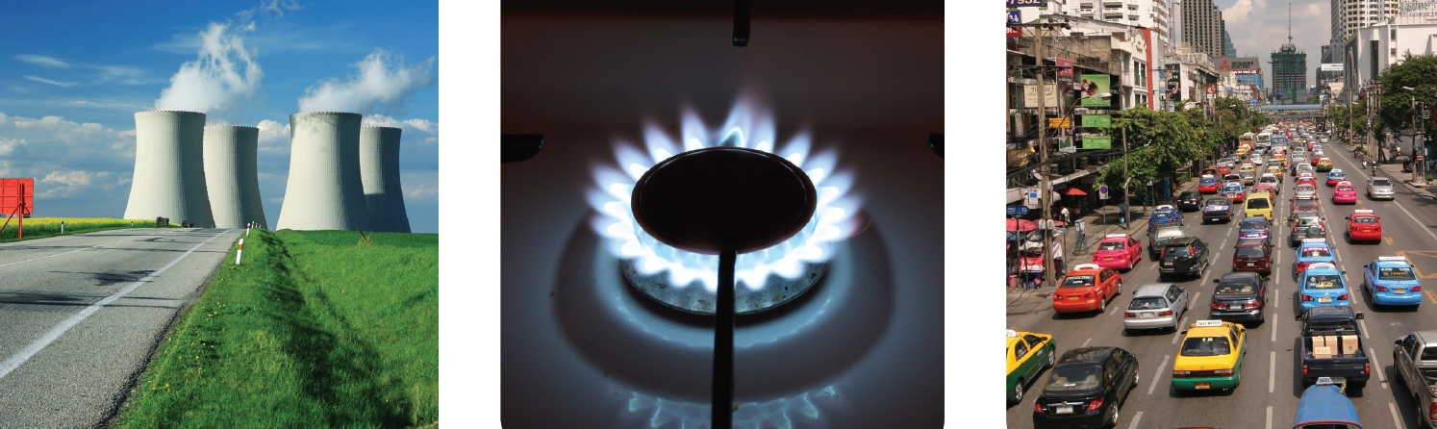
Energy from fuels (燃料)
The fossil fuels(化石燃料) — coal, petroleum (oil), and natural gas (methane)
We burn fossil fuels in power
stations, to heat water to make
steam. A jet of steam drives the
turbines that generate electricity
We burn them in factories to heat
furnaces, and in homes for cooking
and heating. (Kerosene, from
petroleum, is also used in lamps.)
Petrol and diesel (from petroleum)
are burned in engines, to give the
hot gas that moves the pistons.
These then make the wheels turn.

Slide 22
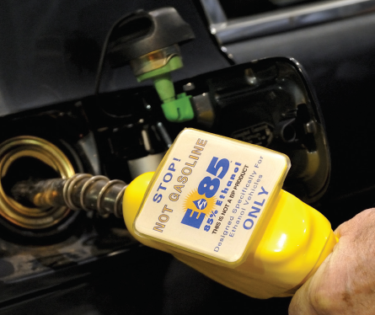
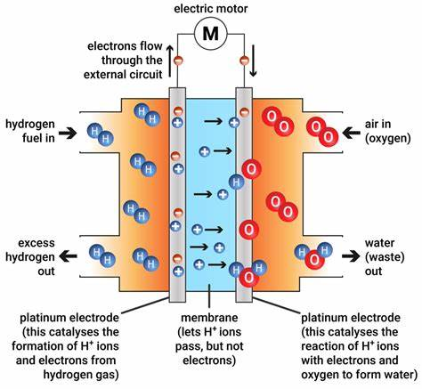
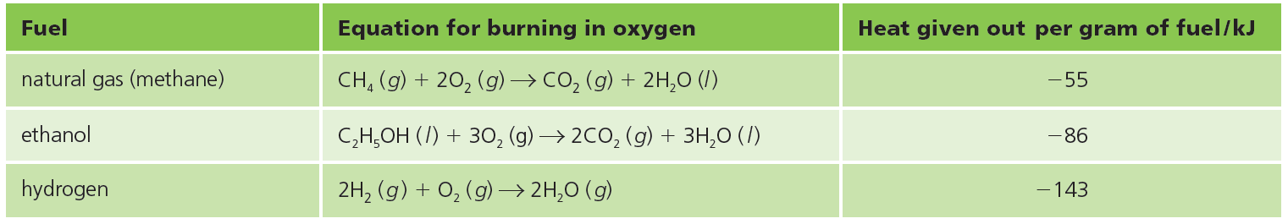
Energy from fuels (燃料)
what makes a good fuel？
Ethanol This is an alcohol, with the formula C₂H₅OH. It can be made from any plant material. For example, it is made from sugar cane, and from corn (maize). It is used in car engines, on its own or mixed with petrol.
Hydrogen This gas burns explosively in oxygen, giving out a lot of
Energy — so it is used to fuel space rockets. It is also used in fuel cells
(without burning) to give energy in the form of electricity
Filling up with a mixture of 85% ethanol, 15% gasoline.
fuel cells

Slide 23
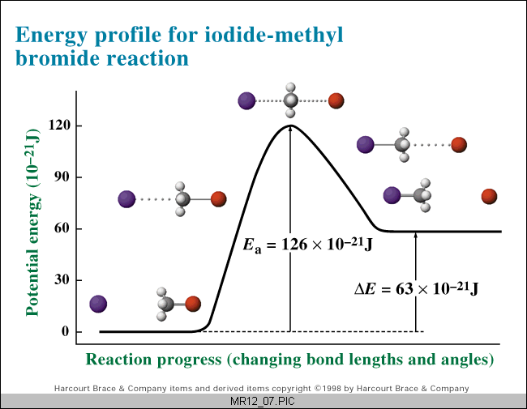
Energy Diagram
energy change during a chemical reaction

Slide 24
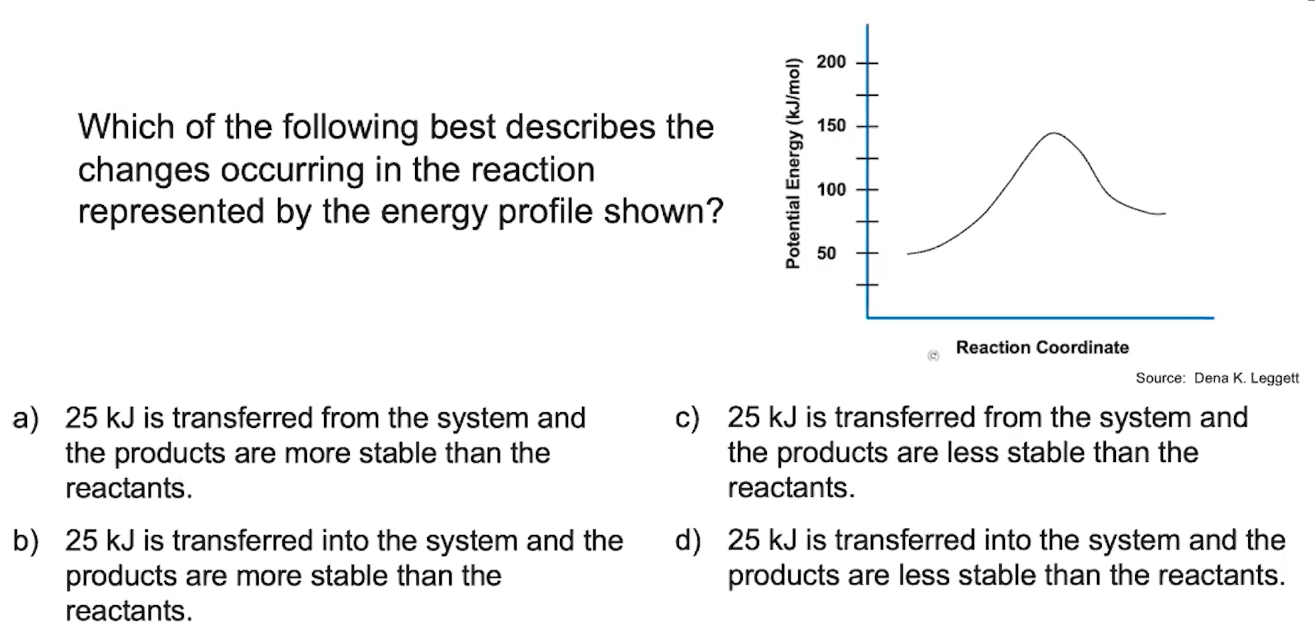

Slide 25
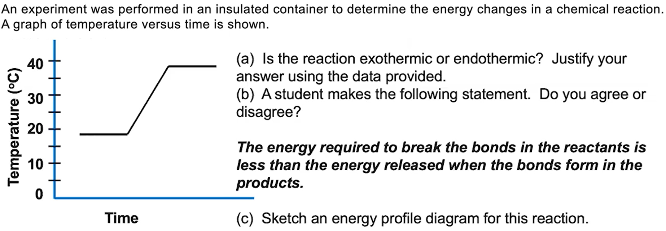
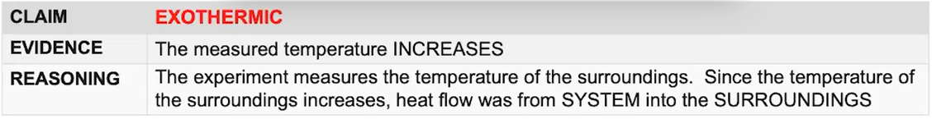

Slide 26
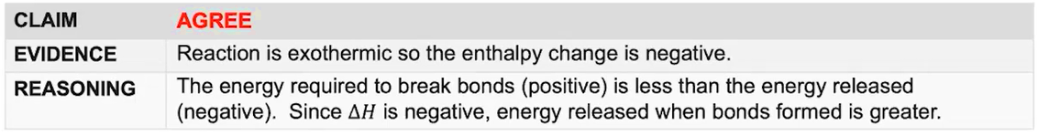

Slide 27
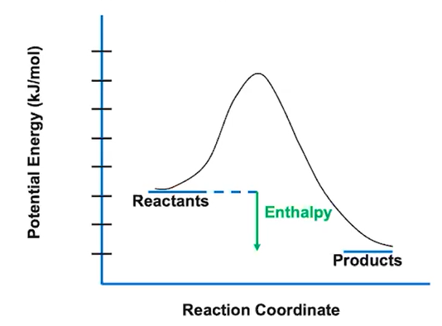

Slide 28
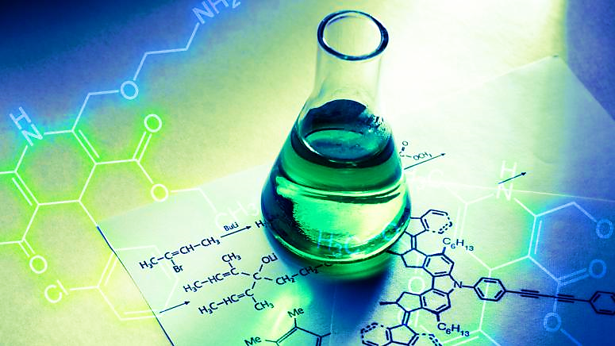

Part 2 1
Kinetics
Kinetics 动力学

Slide 29
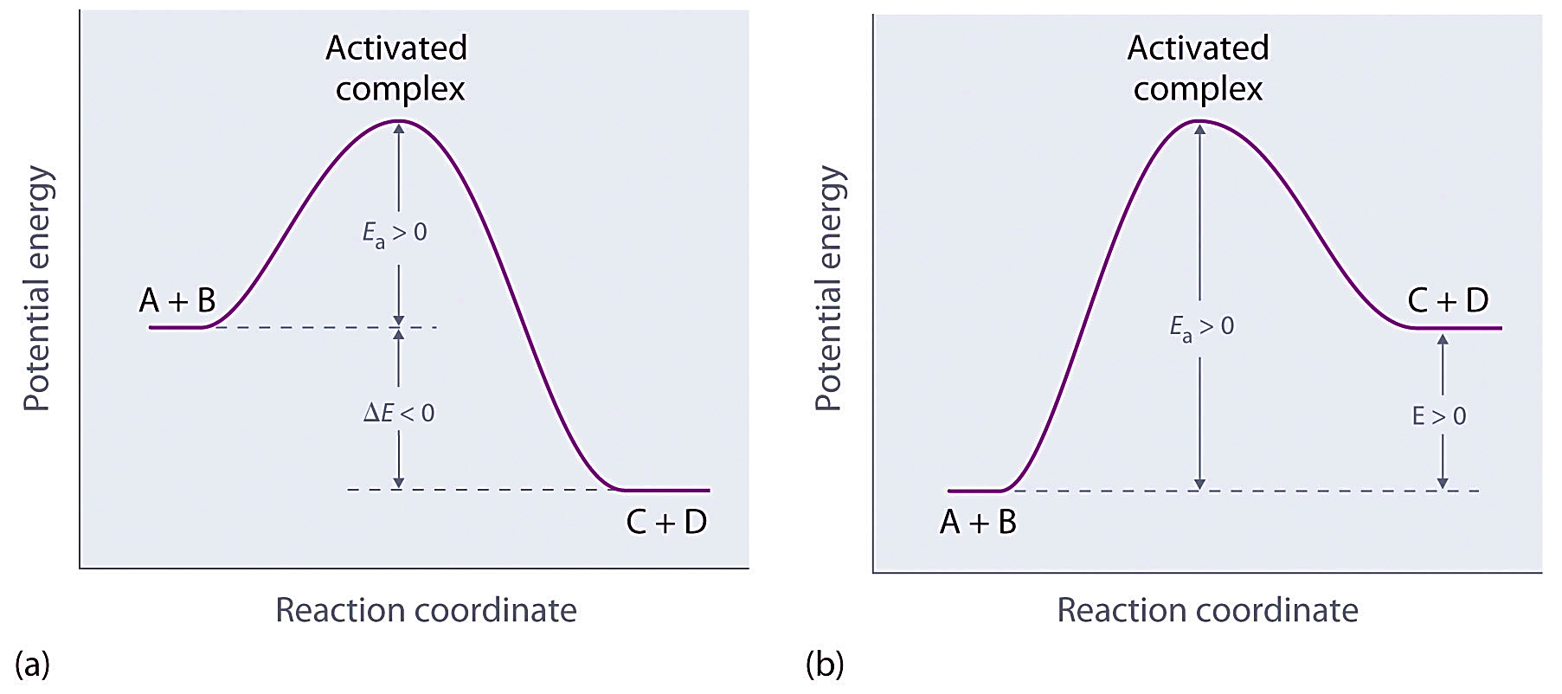
Kinetics
Chemical kinetics
the study of reaction rates
factors that affect rates

Slide 30
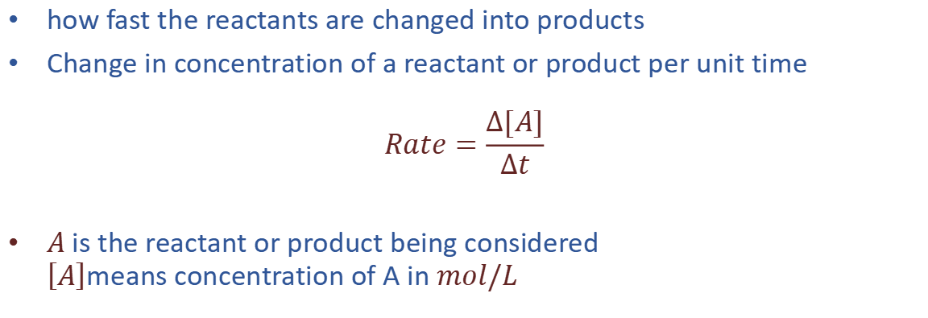
Reaction Rate
Reaction Rate
how fast the reactants are changed into products
Change in concentration of a reactant or product per unit time
$$Rate=\frac{∆[A]}{∆t}$$
$A$is the reactant or product being considered $\left[A\right]$means concentration of A in $mol/L$

Slide 31
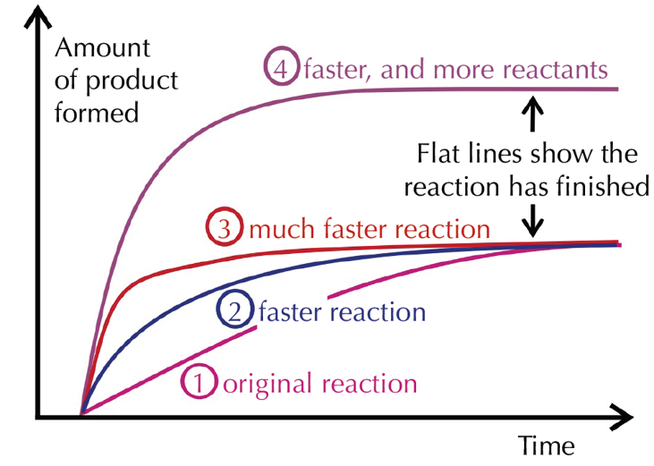
Reaction Rate
how the speed of a particular reaction varies under different conditions

Slide 32
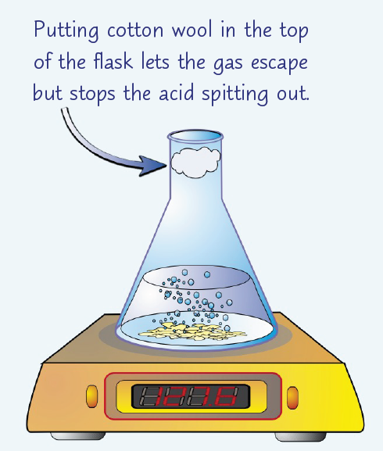
Measuring Rates of Reaction
Change in Mass (Usually Gas Given Off )
measure the rate of a reaction that produces a gas using a mass balance

Slide 33
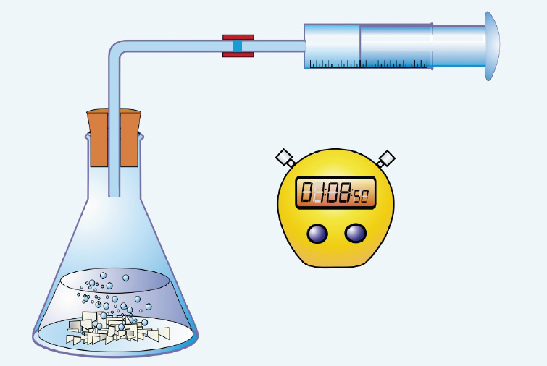
Measuring Rates of Reaction
The Volume of Gas Given Off
use of a gas syringe to measure the volume of gas given off

Slide 34
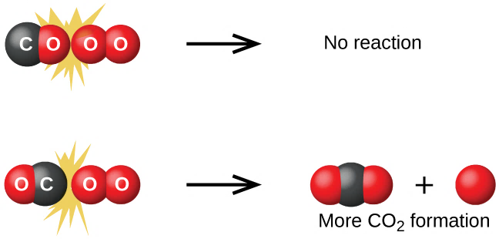
Factors Affecting Reaction Rate
Collision Model 碰撞理论
The more collisions there are, the faster the reaction is.
Successful collisions occur if the particles...
have correct orientation
have sufficient kinetic energy to break bonds

Slide 35
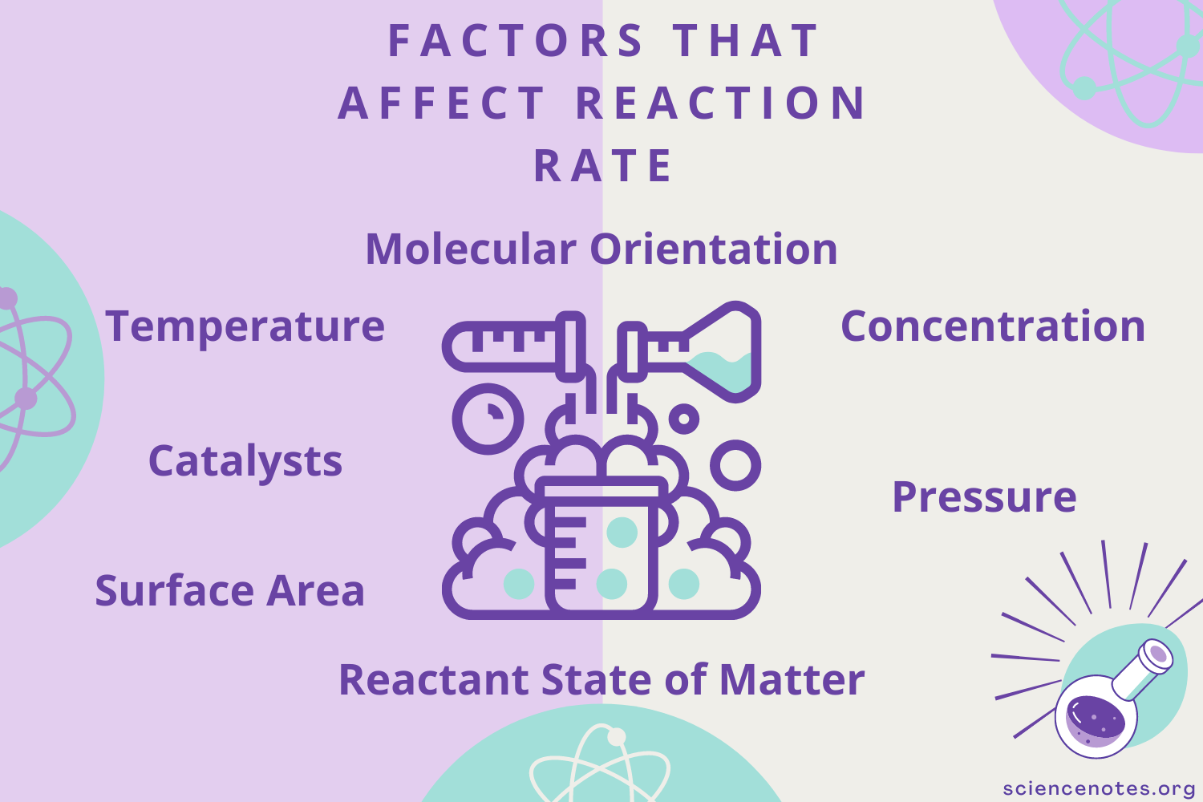
Factors Affecting Reaction Rate
temperature
concentration
pressure
surface area
catalyst

Slide 36
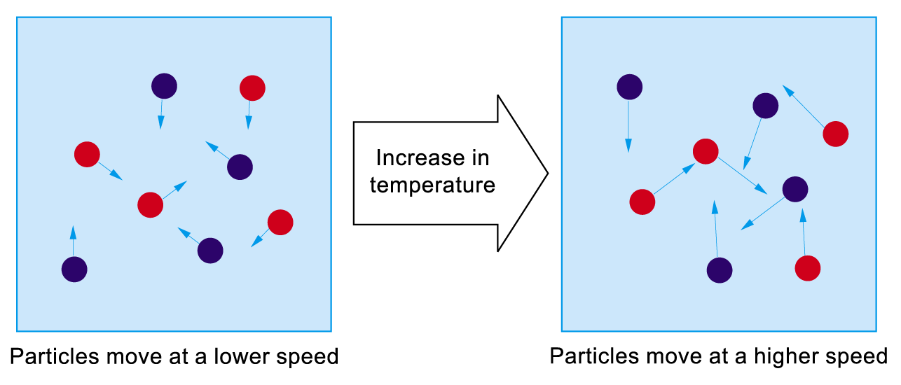
Factors Affecting Reaction Rate
Temperature
Increase in temp. ⇒ increase the kinetic energy of reactant particles ⇒ increase the No. of effective collision per unit time (↑collision frequency & ↑ proportion of high energy collisions)

Slide 37


Factors Affecting Reaction Rate
Temperature
T ↑ ⇒ rate ↑ because :
particles moving around more quickly, increases the frequency of collisions
the proportion of successful collisions increases because the proportion of particles exceeding the activation energy increases.

Slide 38

Factors Affecting Reaction Rate
Concentration of Reactants
higher conc. ⇒ higher frequency of collisions
⇒ higher reaction rate

Slide 39

Factors Affecting Reaction Rate
Pressure
For reactions involving gaseous reactants, higher pressure ⇒ higher conc. ⇒ higher frequency of collisions ⇒ higher reaction rate
As solids and liquids are incompressible, pressure change may not have significant effect on rate of reactions which just involve them.

Slide 40

Factors Affecting Reaction Rate
Surface Area
The smaller size of a solid reactant ⇒ the greater contact surface area between the reactants ⇒ the higher frequency of collisions

Slide 41

Factors Affecting Reaction Rate
Catalyst
A catalyst is a substance that alters the rate of a chemical reaction and remains chemically unchanged at the end of the reaction.
Uncatalysed reaction not completed after months
MnO₂ as catalyst: rate significantly increased
Reason: Reaction through an alternative pathway
2H₂O₂(aq) → 2H₂O(l) + O₂(g)

Slide 42



Factors Affecting Reaction Rate
Catalyst
Provides a new pathway for the reaction with a lower activation energy
E_{a}
More collisions will have sufficient energy, rate increase

Slide 43

Part 4 1
Thermodynamics
Reversible REACTION and Equilibrium (可逆反应和平衡)
https://www.bilibili.com/video/BV1C34y1v7HK/?spm_id_from=333.337.search-card.all.click&vd_source=b9cb3f6cec3babbf8eabad75c8245e6d

Slide 44



Reversible reactions
When you heat copper(II) sulfate crystals …
The blue crystals above are hydrated
copper(II) sulfate. On heating,
they turn to a white powder. This is
anhydrous copper(II) sulfate:
CuSO₄.5H₂O(s)$→$CuSO₄(s) + 5H₂O(l)
The reaction is easy to reverse: add
water! The anhydrous copper(II)
sulfate gets hot and turns blue.
The reaction is:
CuSO₄(s) + 5H₂O(l)$→$CuSO₄.5H₂O(s)

Slide 45


Reversible reactions
Reversible reaction(可逆反应) can goes forward and backward
CuSO₄.5H₂O(s) $⇌$CuSO₄(s) + 5H₂O(l)
A reversible reaction is endothermic in one direction, and exothermic in the other.
The same amount of energy is transferred each time

Slide 46

Reversible reactions
Some important reversible reactions

Slide 47

Equilibrium
Chemical Equilibrium ‒ Reversible Reactions
Three molecules of hydrogen react
with one of nitrogen to form two of
ammonia. So if you put the correct
mixture of nitrogen and hydrogen
into a closed container …
… will it all turn into ammonia?
No! Once a certain amount of
ammonia is formed, the system
reaches a state of dynamic
equilibrium. From then on …
… every time two ammonia
molecules form, another two
break down into nitrogen and
hydrogen. So the level of ammonia remains unchanged.
Notes:
先说明一些化学反应会一直进行，直到一种反应物完全反应掉为止。画出这种情况的浓度/速率-时间图像。再讲述平衡。
A state of balance at which the rates of the forward and reverse reactions are equal.

Slide 48



Equilibrium
Chemical Equilibrium ‒ Reversible Reactions
H₂(g) + I₂(g) ⇌ 2HI(g)
RATE of forward rxn = Rate of backword rxn
In a closed system, a reversible reaction reaches a state of dynamic equilibrium(动态平衡), where the forward and back reactions take place at the same rate. So there is no overall change.
Notes:
先说明一些化学反应会一直进行，直到一种反应物完全反应掉为止。画出这种情况的浓度/速率-时间图像。再讲述平衡。
A state of balance at which the rates of the forward and reverse reactions are equal.

Slide 49

Part 5 1
Equilibrium
Le Châtelier’s Principle (列夏特列原理-“对着干”)

Slide 50

Le Châtelier’s Principle
Equilibrium Position
The rate of the forward reaction is equal to the rate of the reverse reaction
The relative concentrations of reactants and products at equilibrium.
At this point the concentrations don’t change unless a stress is applied to change the equilibrium.

Slide 51
Le Châtelier’s Principle
Le Châtelier’s Principle (勒夏特列原理)-Shifting the equilibrium
Change:
Concentration
Temperature
Pressure
When a reversible reaction is in equilibrium and you make a change, the system acts to oppose the change, and restore equilibrium. A new equilibrium mixture forms.

Slide 52

Le Châtelier’s Principle

Slide 53


