Slide 1
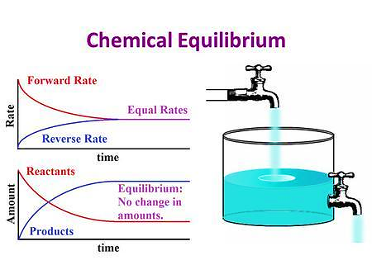

Part 3 1
Thermodynamics
Reversible REACTION and Equilibrium
(可逆反应和平衡)
https://www.bilibili.com/video/BV1C34y1v7HK/?spm_id_from=333.337.search-card.all.click&vd_source=b9cb3f6cec3babbf8eabad75c8245e6d

Slide 2
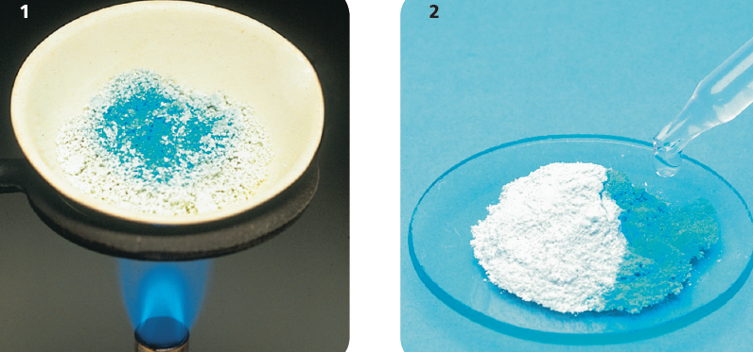
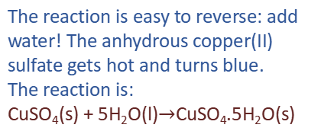
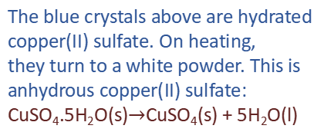

Reversible reactions
When you heat copper(II) sulfate crystals …
The blue crystals above are hydrated
copper(II) sulfate. On heating,
they turn to a white powder. This is
anhydrous copper(II) sulfate:
CuSO₄.5H₂O(s)$→$CuSO₄(s) + 5H₂O(l)
The reaction is easy to reverse: add
water! The anhydrous copper(II)
sulfate gets hot and turns blue.
The reaction is:
CuSO₄(s) + 5H₂O(l)$→$CuSO₄.5H₂O(s)

Slide 3
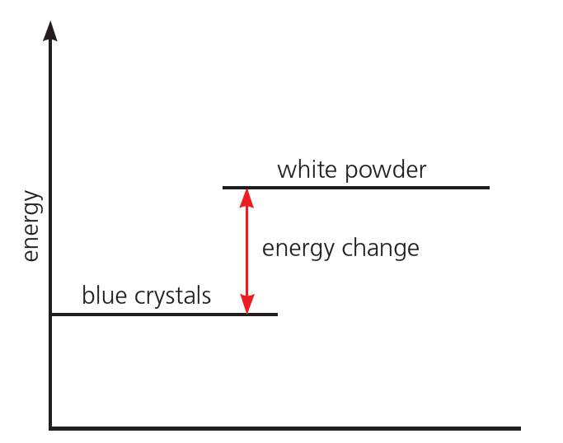
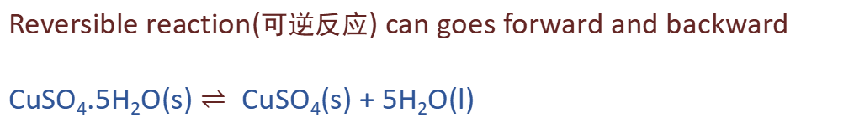
Reversible reactions
Reversible reaction(可逆反应) can goes forward and backward
CuSO₄.5H₂O(s) $⇌$CuSO₄(s) + 5H₂O(l)
A reversible reaction is endothermic in one direction, and exothermic in the other.
The same amount of energy is transferred each time

Slide 4
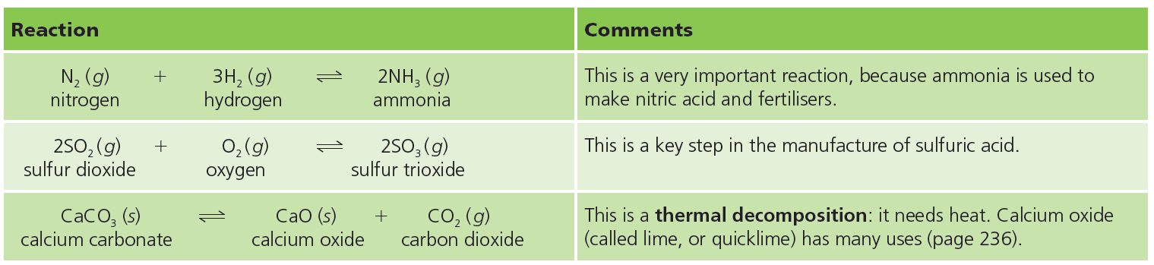
Reversible reactions
Some important reversible reactions

Slide 5
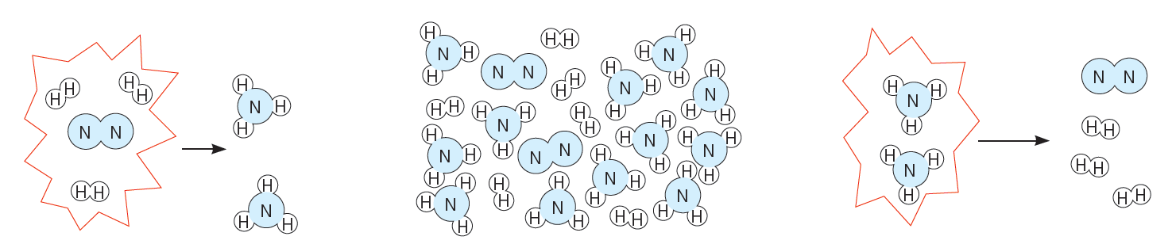
Equilibrium
Chemical Equilibrium ‒ Reversible Reactions
Three molecules of hydrogen react
with one of nitrogen to form two of
ammonia. So if you put the correct
mixture of nitrogen and hydrogen
into a closed container …
… will it all turn into ammonia?
No! Once a certain amount of
ammonia is formed, the system
reaches a state of dynamic
equilibrium. From then on …
… every time two ammonia
molecules form, another two
break down into nitrogen and
hydrogen. So the level of ammonia remains unchanged.
Notes:
先说明一些化学反应会一直进行，直到一种反应物完全反应掉为止。画出这种情况的浓度/速率-时间图像。再讲述平衡。
A state of balance at which the rates of the forward and reverse reactions are equal.

Slide 6
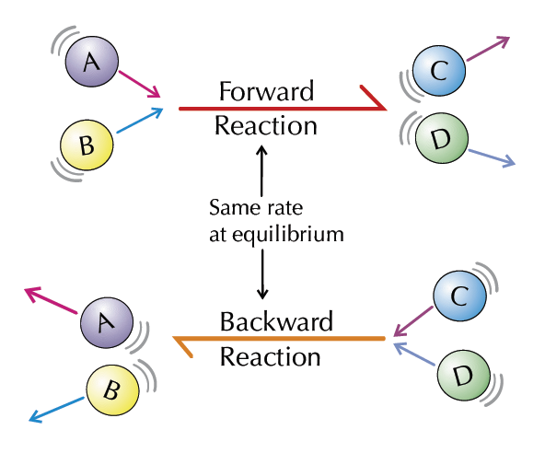
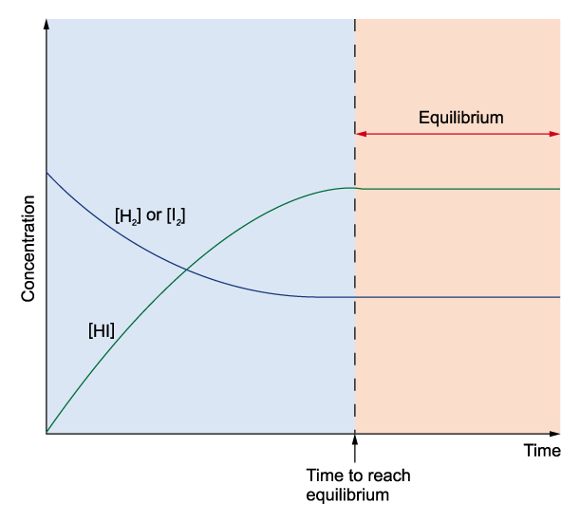
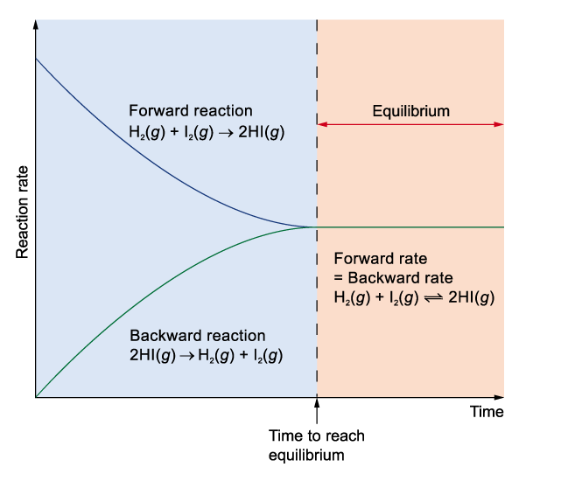
Equilibrium
Chemical Equilibrium ‒ Reversible Reactions
H₂(g) + I₂(g) ⇌ 2HI(g)
RATE of forward rxn = Rate of backword rxn
In a closed system, a reversible reaction reaches a state of dynamic equilibrium(动态平衡), where the forward and back reactions take place at the same rate. So there is no overall change.
Notes:
先说明一些化学反应会一直进行，直到一种反应物完全反应掉为止。画出这种情况的浓度/速率-时间图像。再讲述平衡。
A state of balance at which the rates of the forward and reverse reactions are equal.

Slide 7
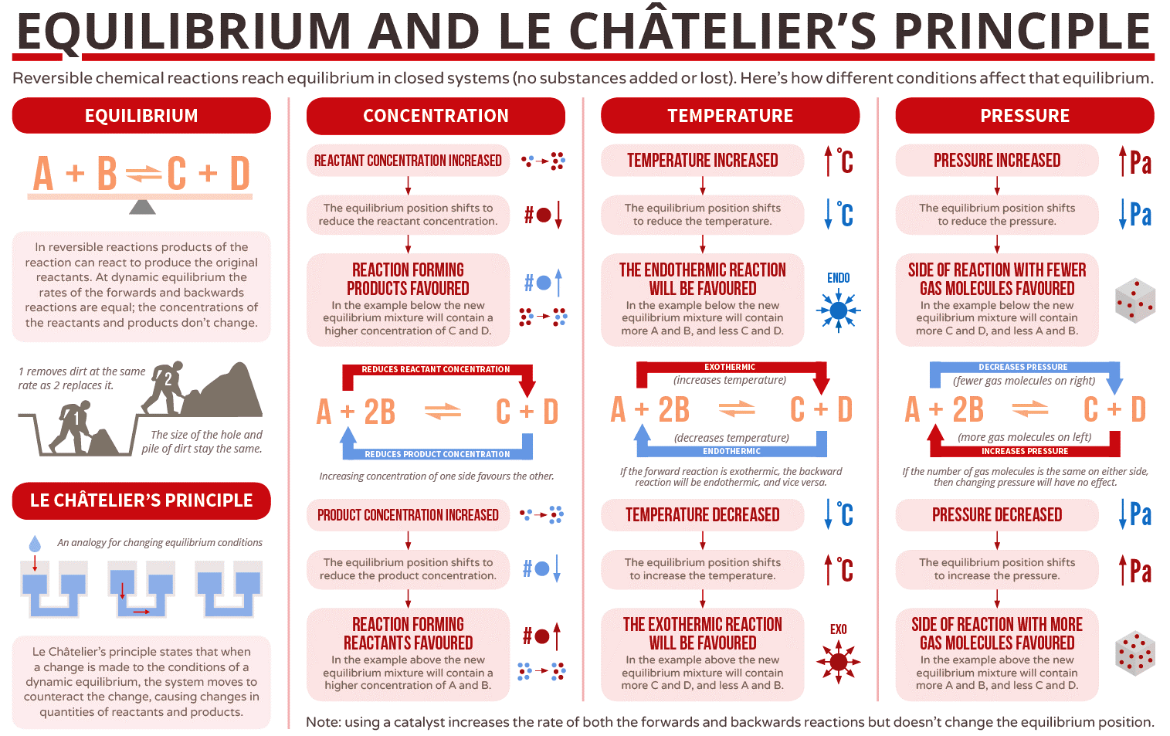
Part 4 1
Equilibrium
Le Châtelier’s Principle
(勒夏特列原理-“对着干”)

Slide 8
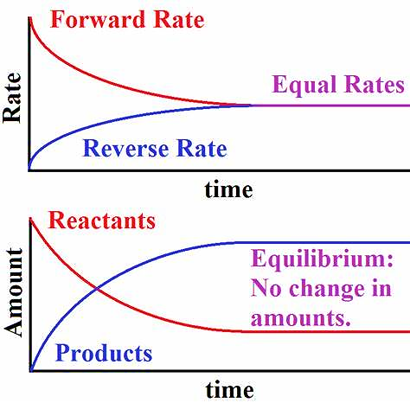
Le Châtelier’s Principle
Equilibrium Position
The rate of the forward reaction is equal to the rate of the reverse reaction
The relative concentrations of reactants and products at equilibrium.
At this point the concentrations don’t change unless a stress is applied to change the equilibrium.

Slide 9
Le Châtelier’s Principle
Le Châtelier’s Principle (勒夏特列原理)-Shifting the equilibrium
Change:
  Concentration
  Temperature
  Pressure
  Catalyst
When a reversible reaction is in equilibrium and you make a change, the system acts to oppose the change, and restore equilibrium. A new equilibrium mixture forms.

Slide 10
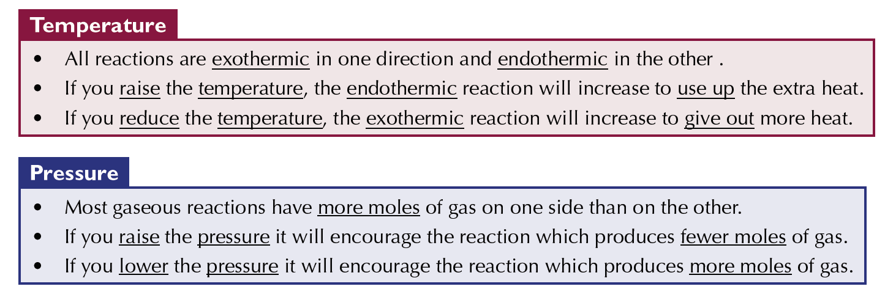
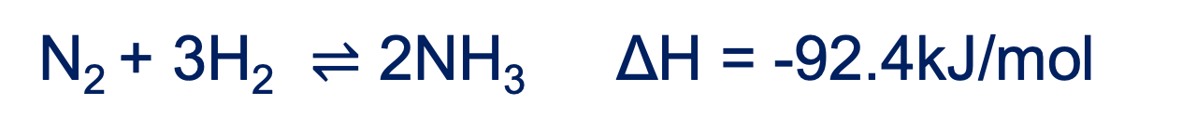
Le Châtelier’s Principle
N₂ + 3H₂ $⇌$ 2NH₃ ΔH = -92.4kJ/mol

Slide 11
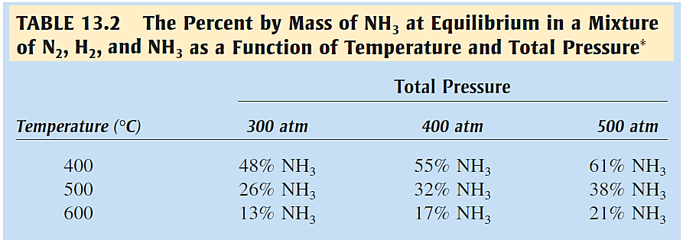
Le Châtelier’s Principle
N₂ + 3H₂ $⇌$ 2NH₃ ΔH = -92.4kJ/mol

Slide 12
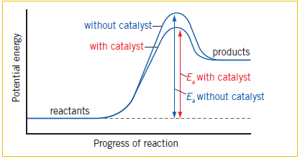
Le Châtelier’s Principle
Effect of Catalyst
The presence of a catalyst in a reversible reaction does not affect the state of equilibrium but only causes the reaction system to attain equilibrium in a shorter period of time.

Slide 13


